Slide 1

MaxTEST Specification
iGame
T12b 3 Step Reg (England Norway Finland)
April 2015

Slide 2
Campaign Overview
Background & Objective
Currently the registration forms are all on a single page.
Showing users a single step with easy data fields to fill in hooks more users into the registration flow, making them less likely to drop out in the following steps.
What Will Be Tested?
The registration page will be altered from a single page into a three stepped form.
How Will We Measure Success?
Registration conversion rate.
2

Slide 3
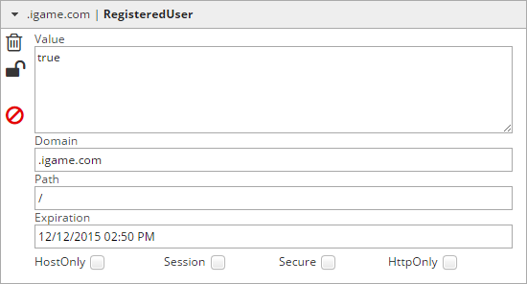
Campaign Generation
Test Page Name: England Norway Finland Signup
Preview URL: https://www.igame.com/en/signup/
Included Page Mask(s): http*://www.igame.com/en/signup/
http*://www.igame.com/fi/signup/
http*://www.igame.com/no/signup/
Excluded Page Mask(s): http*://www.igame.com/sv/signup/
http*://www.igame.com/*/signup/?promocode=*
User status: Unregistered – User with cookie value ‘RegisteredUser = true’ should be excluded
3

Slide 4
Campaign Settings
Element |  | Variant 1 | Variant 2 | Variant 3
A | Page | Default | 3Step_Image | 3Step_NoImage
3 experiences
Campaign Name in UI: T12b_3_Step_Reg_England_Norway_Finland
Campaign Type: A/B
Number of Experiences: 3
Personalisation Criteria: Yes
Segments: No
3rd Party integration: No
Responsive Design: Yes
4

Slide 5
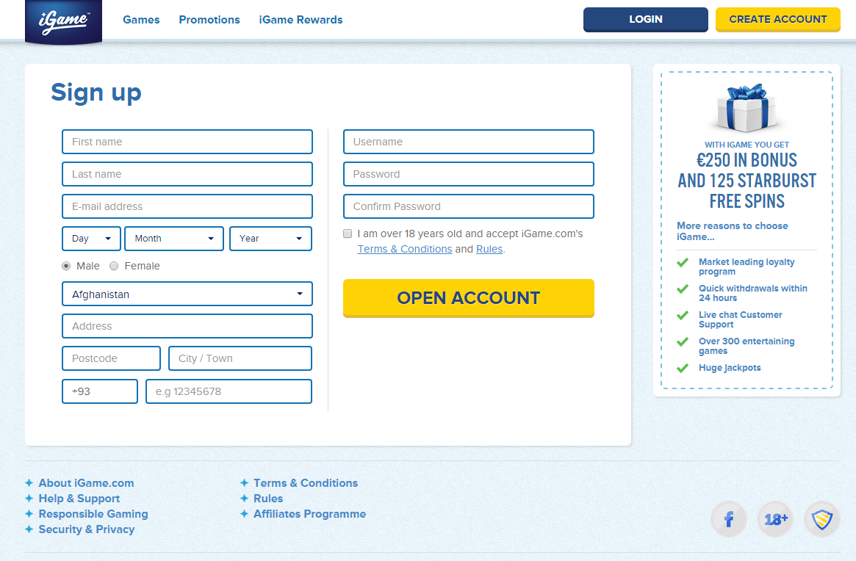
Variant A1
Element ‘A’ | Page | Variant A1 | Default
Description:
The visible content is the ‘Default’ that will be used as a control for this test.
The English Language version is being used to illustrate the changes but the structure is the same for all 3 languages:
EN
NO
FI
Variant Mask(s)
http*://www.igame.com/en/signup/
http*://www.igame.com/no/signup/
http*://www.igame.com/fi/signup/
A
http://www.igame.com/en/signup/
5

Slide 6
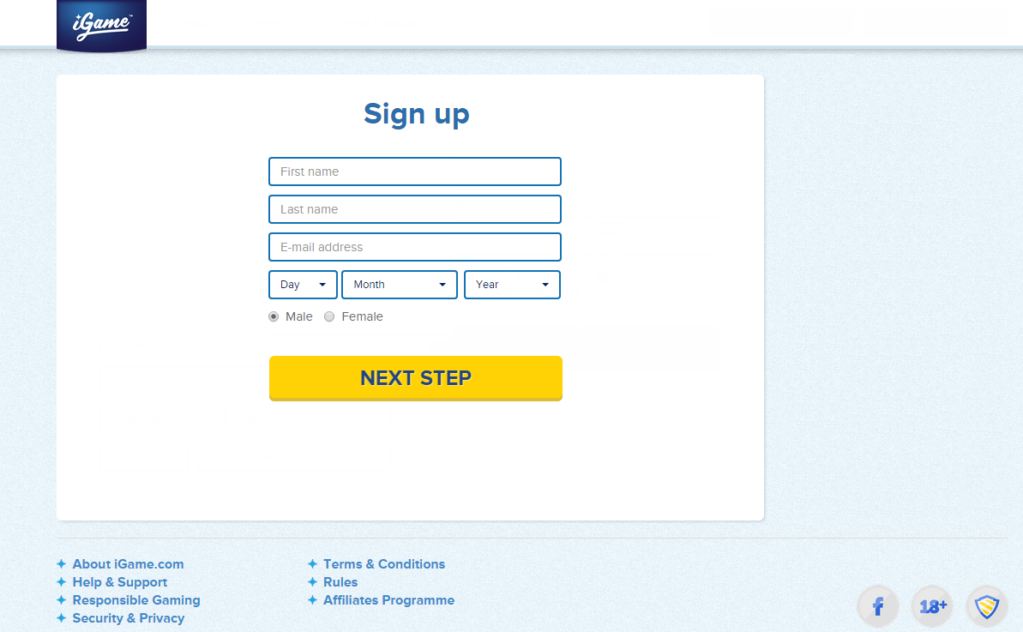
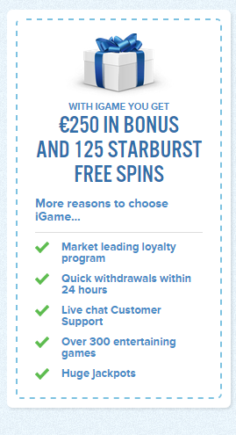
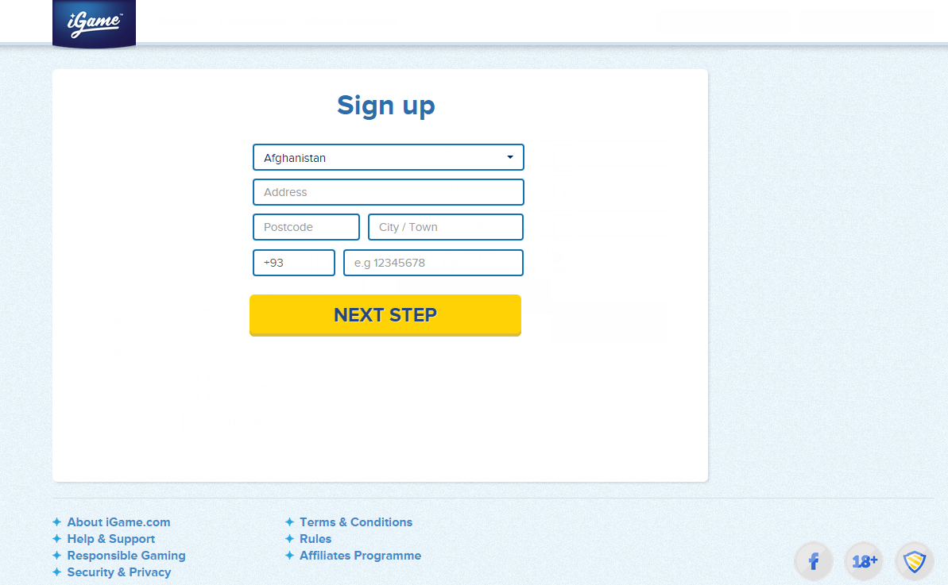
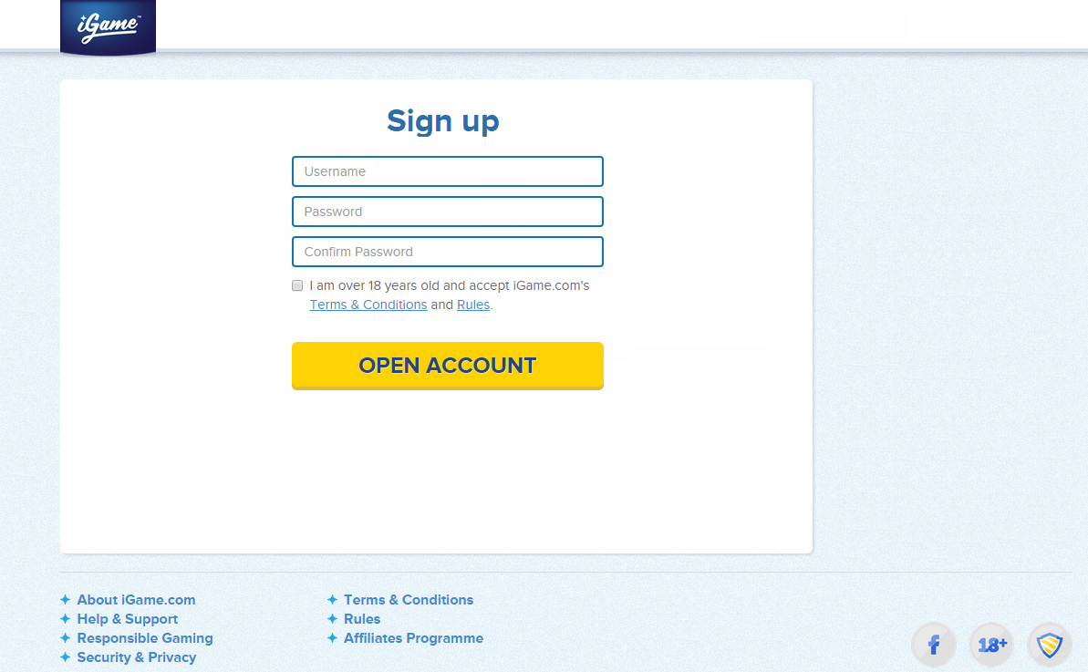
Variant A2
Element ‘A’ | Page | Variant A2 | 3Step_Image
Description:
Links from the top have been removed.
The Sign up header has been centralised.
The page has been split into 3 steps
The user should not be allowed to pass to the next step without all fields being successfully validated.
Variant Mask(s)
http*://www.igame.com/en/signup/
http*://www.igame.com/no/signup/
http*://www.igame.com/fi/signup/
Step 1
First name
Last name
Email
DOB
Gender
NEXT STEP
Step 2
Country
Address
Post code
City
Phone #
NEXT STEP
Step 3
Username
Password
Confirm Password
Accept T&Cs
NEXT STEP
Translations of NEXT STEP:
FIN: Jatka
NOR: Fortsett
6

Slide 7
Variant A3
Element ‘A’ | Page | Variant A3 | 3Step_NoImage
Description:
Links from the top have been removed.
The Sign up header has been centralised.
The page has been split into 3 steps.
The image on the right has been removed.
The user should not be allowed to pass to the next step without all fields being successfully validated.
Variant Mask(s)
http*://www.igame.com/en/signup/
http*://www.igame.com/no/signup/
http*://www.igame.com/fi/signup/
Step 1
First name
Last name
Email
DOB
Gender
NEXT STEP
Step 2
Country
Address
Post code
City
Phone #
NEXT STEP
Step 3
Username
Password
Confirm Password
Accept T&Cs
NEXT STEP
Translations of NEXT STEP:
FIN: Jatka
NOR: Fortsett
7

Slide 8
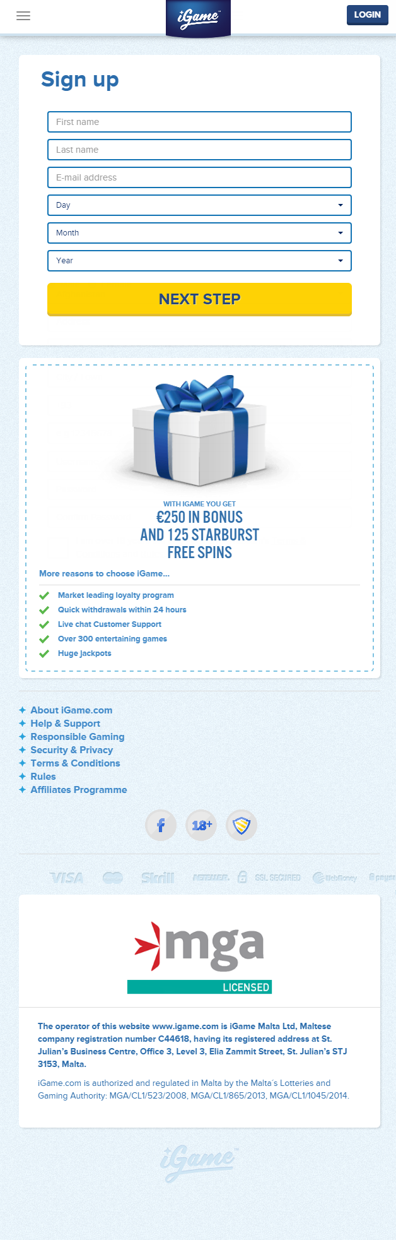
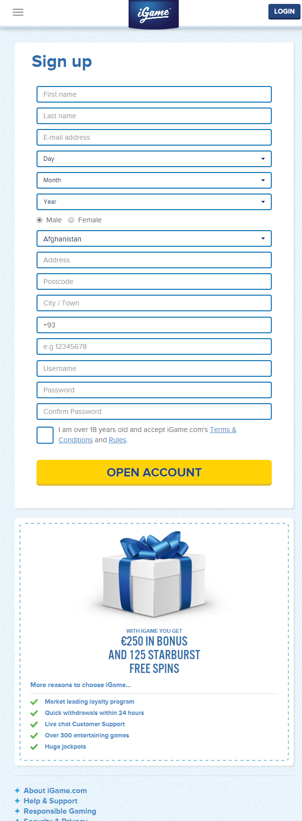
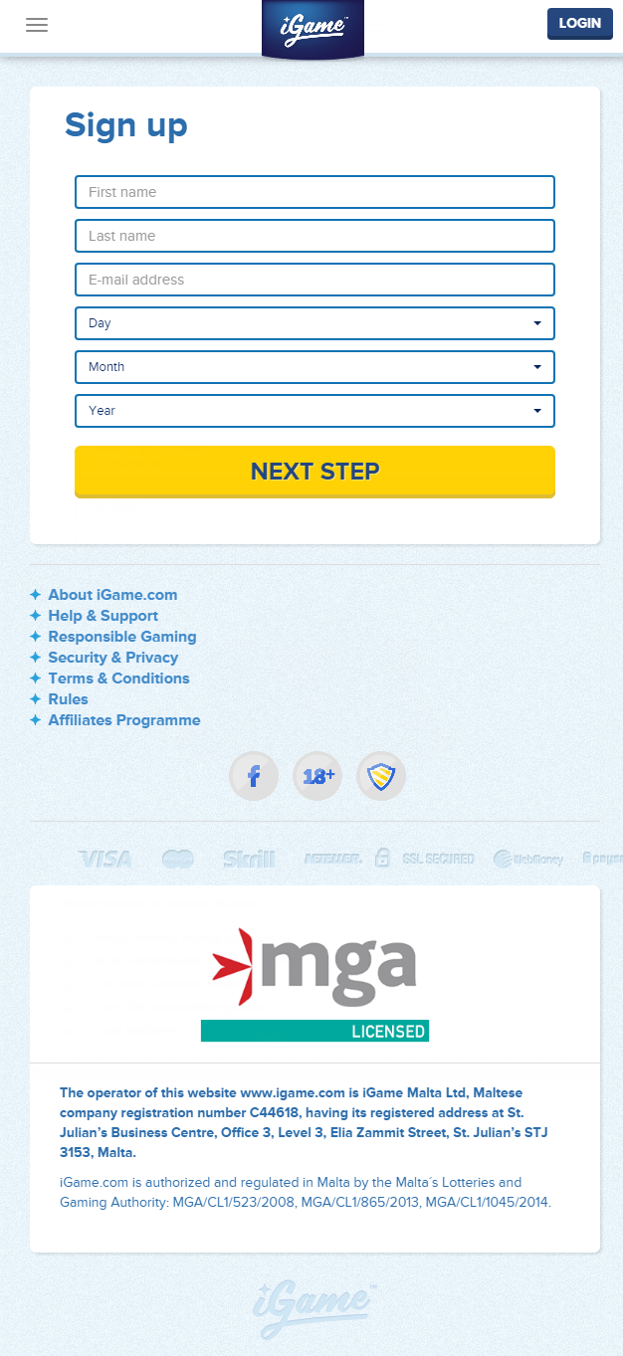
Responsive Design
Default
Variant A2_Step1
Variant A3_Step1
8

Slide 9
Metric Overview
Action | Name | Description | Value | Attributes | Level | Type | New
Primary | Registration | A user successfully registers an account. | - | - | Site | On Load | ✗
Secondary | First Deposit | A user makes a first deposit. | EUR | Payment Method | Site | On Load | ✗
Secondary | Step One | A user focuses on one of the fields in the first step and enters a value. Includes radio button and dropdowns. | - | - | Campaign | On Event | ✓
Secondary | Step Two | A user focuses on one of the fields in the second step and enters a value. Includes radio button and dropdowns. | - | - | Campaign | On Event | ✓
Secondary | Step Three | A user focuses on one of the fields in the third step and enters a value. Includes radio button and dropdowns. | - | - | Campaign | On Event | ✓
9

Slide 10
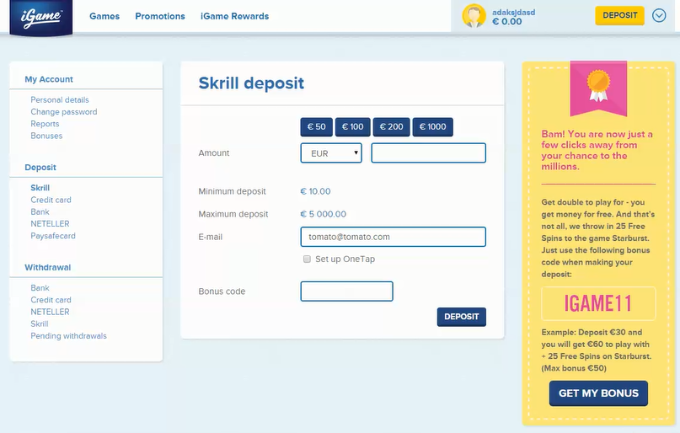
Metrics – Registration
Description
A user successfully registers an account.
URL: https://www.igame.com/*?registration=1
10

Slide 11
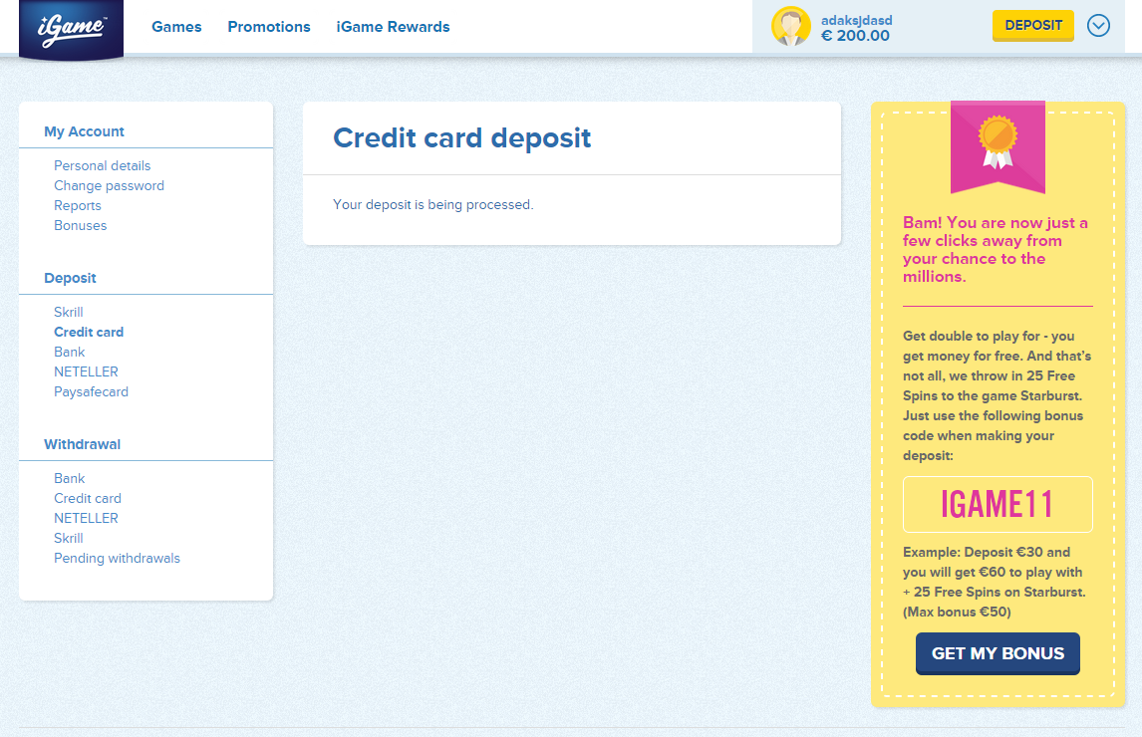
Metrics – First Deposit
Description
A user makes a first deposit. Please see next slide for attributes and URLs.
NOTE: We can only test Bank and Credit Card deposits using the iGame staging environment. Other payment methods will have to be QAed by iGame to ensure the action is tracking for all payment methods. Please use Staging Environment - https://staging.igame.com/
The value of the deposit can be taken from the page before from the amount field.
11

Slide 12
Metrics – First Deposit
Attributes and URLs
Bank https://www.igame.com/*/deposit/finalize?*orderstatus=OK
Credit Card https://www.igame.com/*/deposit/creditcard
NETELLER https://www.igame.com/*/deposit/neteller
Skrill https://www.igame.com/*/deposit/skrill
Paysafecard https://www.igame.com/*/deposit/paysafecard
PugglePay https://www.igame.com/*/deposit/pugglepay
Siru Mobile https://www.igame.com/*/deposit/siru
Deposit Identifier
The URL of the page does not change for all deposit methods when a deposit has been made. Below is the text on the page which can be used to identify a deposit has been made:
EN: Your deposit is being processed.
FI: Talletustasi käsitellään.
NO: Ditt innskuddet blir behandlet.
12

Slide 13
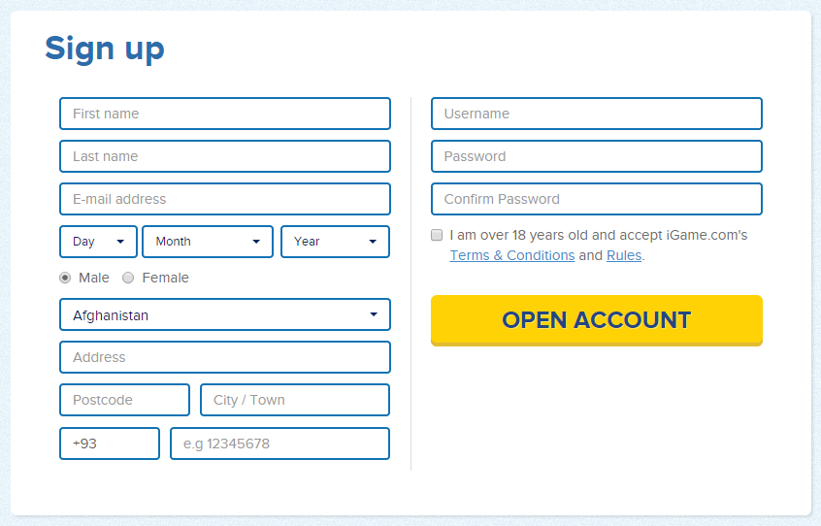
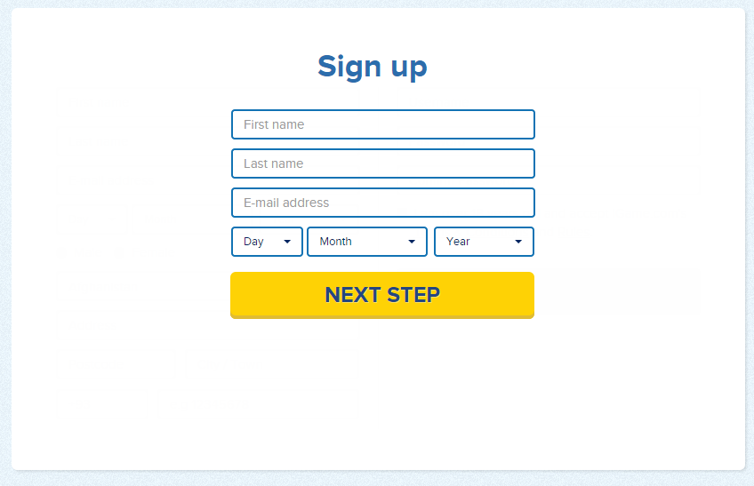
Metrics – Step One
Description
A user focuses on one of the fields in the first step and enters a value. Includes radio button and dropdowns.
URL: https://www.igame.com/*/signup/?*
Default
Variant
13

Slide 14
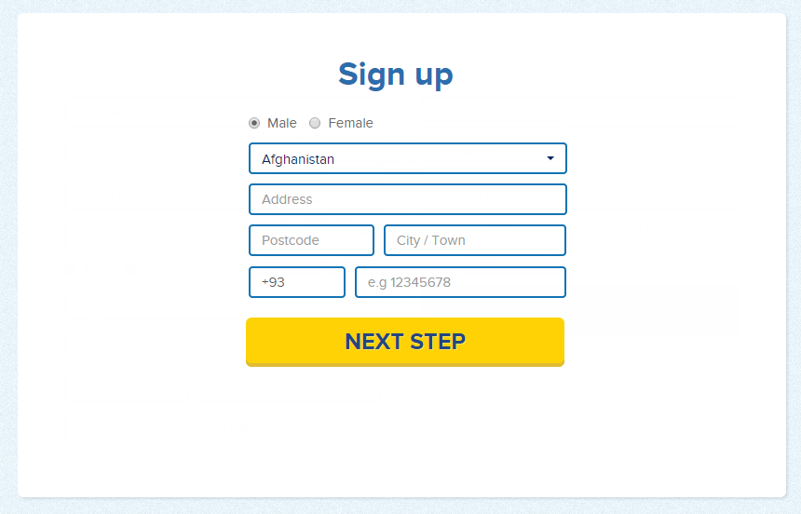
Metrics – Step Two
Description
A user focuses on one of the fields in the second step and enters a value. Includes radio button and dropdowns.
URL: https://www.igame.com/*/signup/?*
Default
Variant
14

Slide 15
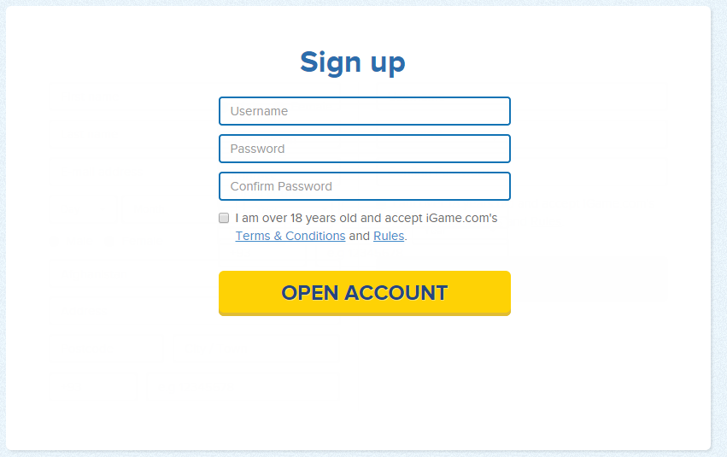
Metrics – Step Three
Description
A user focuses on one of the fields in the third step and enters a value. Includes radio button and dropdowns.
URL: https://www.igame.com/*/signup/?*
Default
Variant
15

Slide 16
Browser Rules
The browser rules below define which devices and browsers will be included in the campaign.
16

Slide 17
Personalisation Criteria
Page or page type that the criteria is captured on:
https://www.igame.com/*
Values to record:
Registered User = True
Registered User = False
If visitor has ever logged in PC Value = True
If the visitor has never registered or logged in PC Value = False.
See the following slides for more details
Should this criteria be present in all cases?
Yes
17

Slide 18
Prepared by:
Marco Giglio
Senior Analyst
Telephone: 0203 375 0197
Email: marco.giglio@maxymiser.com
Maxymiser Ltd
121 Great Portland Street, London, W1W 6QL
Notes:
18

